Slide 1


Analytical Visualization on the Stack Overflow Developer Survey 2017
NIkhil Korati Prasanna
108190828

Slide 2


This presentation is a visual insight into the stack overflow developer survey 2017 results.
Stack Overflow is the world’s largest open developer community. Analyzing the data about its developers will be interesting from budding developer’s perspective who want to contribute to the community.
As an Analyst my perspective of what the survey results are:
*The data has been cleaned with reduced number of variables and observations for interpretation purposes

Slide 3
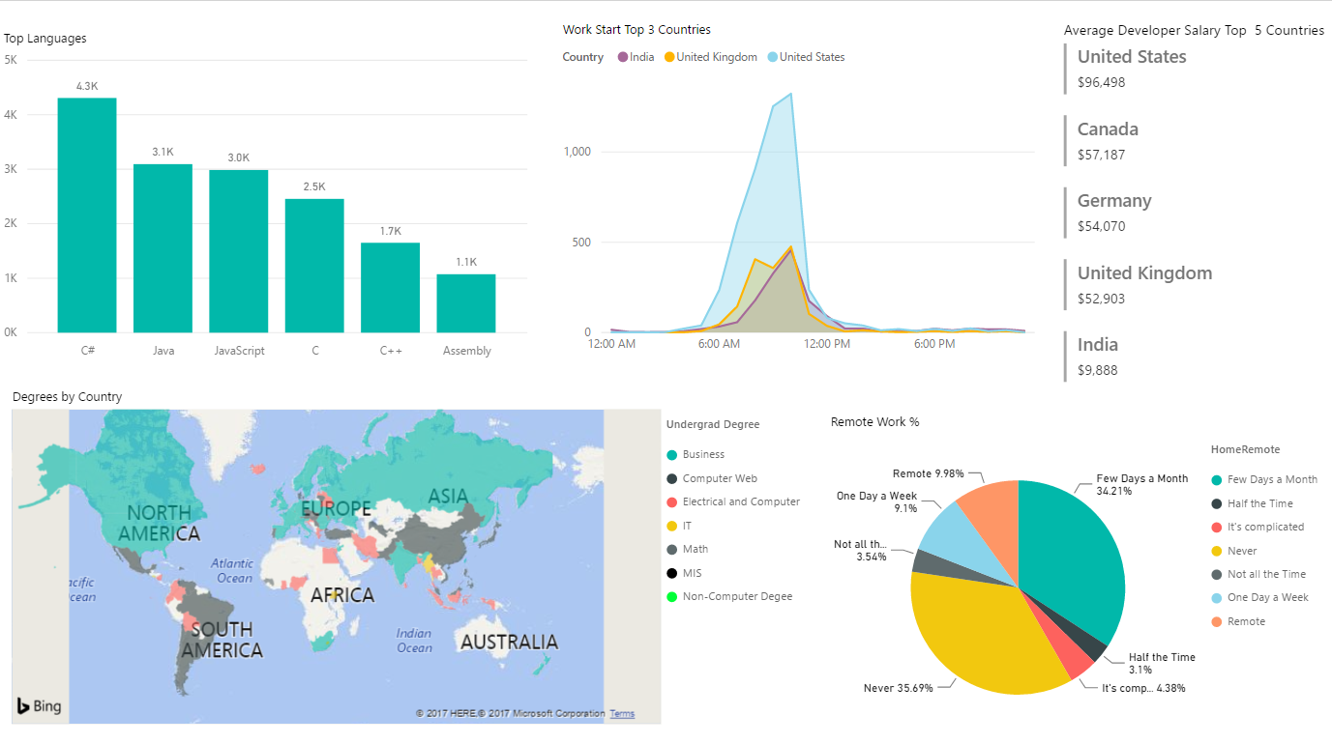
Overview Dashboard

Slide 4
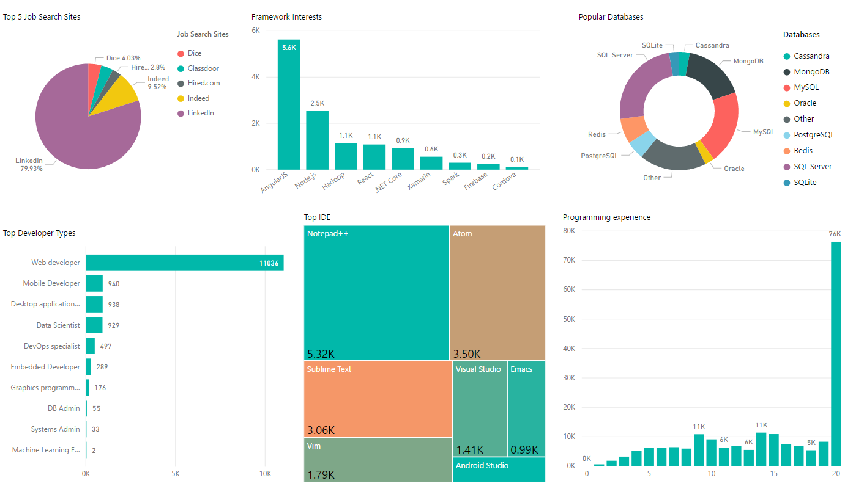
Popular Dashboard

Slide 5
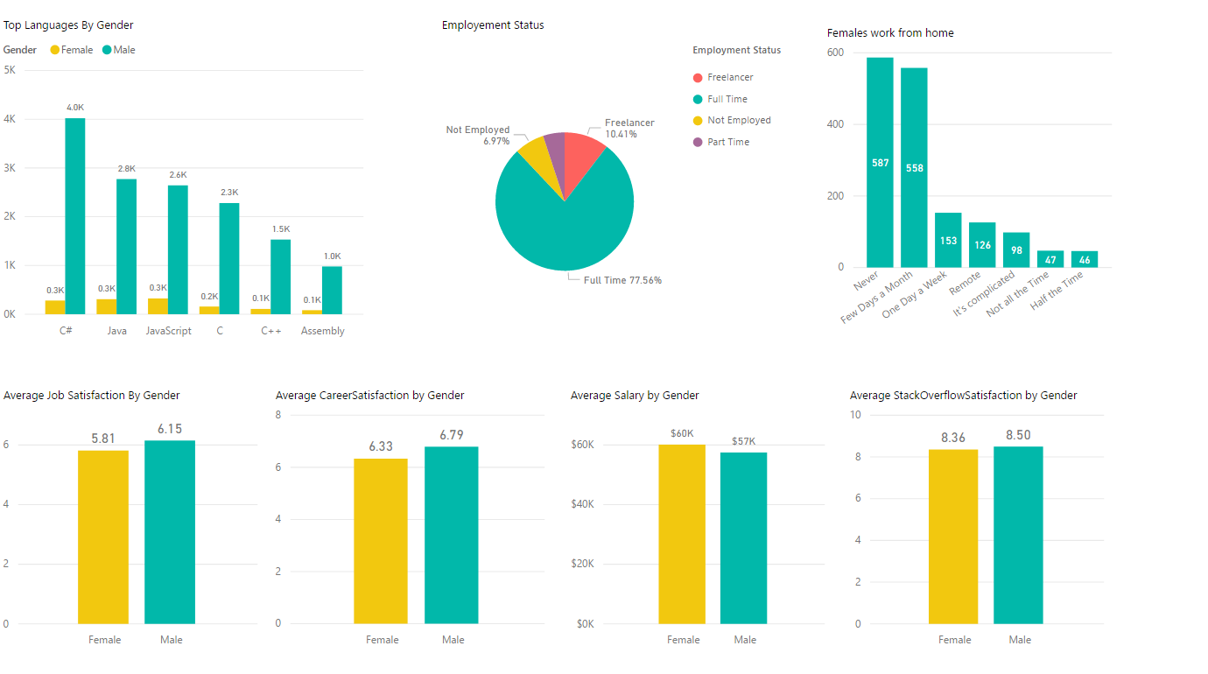
Comparison Dashboard

Slide 6
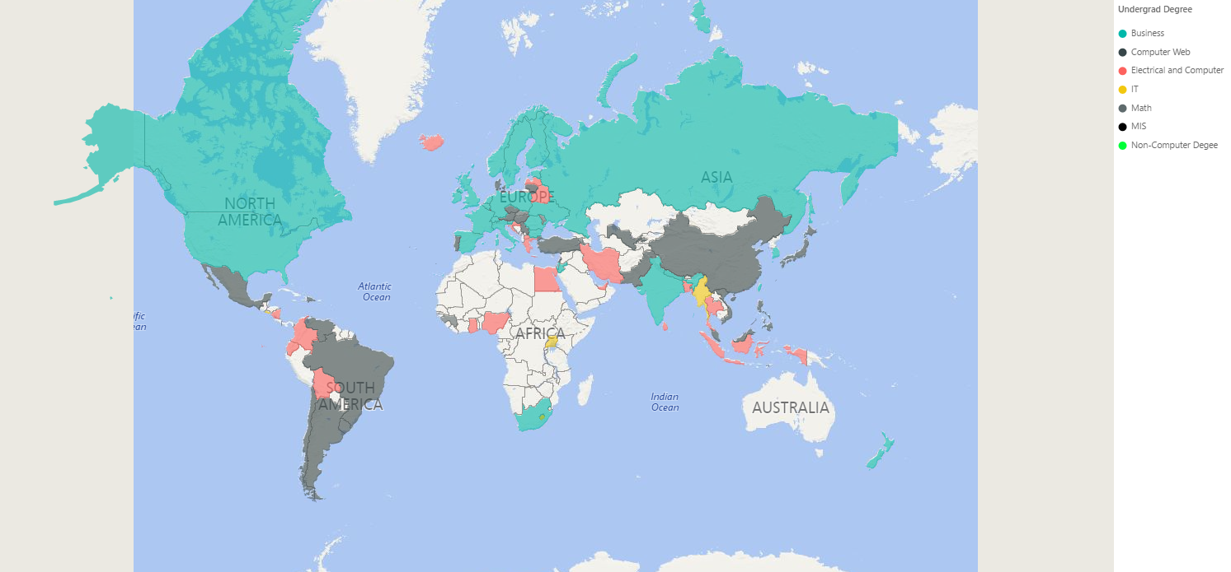
Developers from North America, Asia, Europe and India have an undergrad degree in Business Developers from Mexico, China, Brazil and Argentina have an undergrad degree in Web

Slide 7
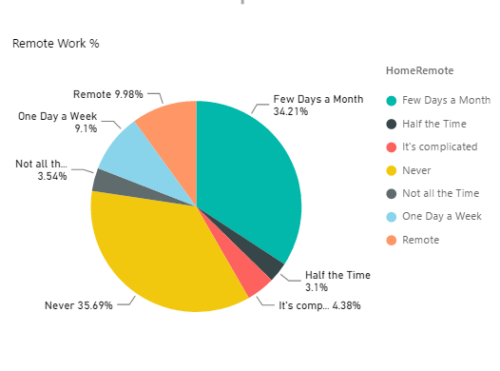
Most of the stack overflow developers prefer not to work from home or just work from home a few days a month.

Slide 8
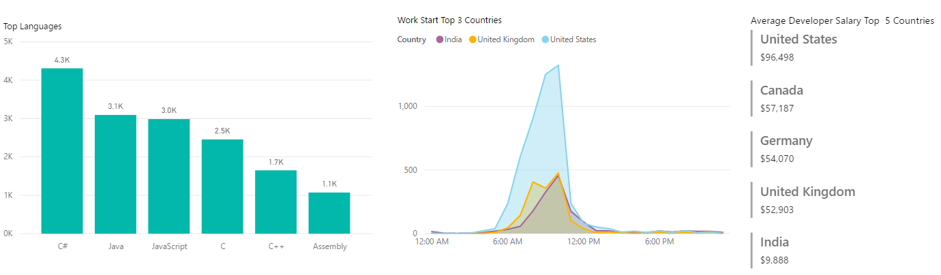
C# is the most popular programming language with 4.3K developers using it. Interestingly Assembly language is among the top 5 popular languages.
Most of the developers in India, US and UK start their work anywhere between 6:00AM and 12:00PM Few developers start their work as early as 12:00AM and as late as 6:00PM
US tops the list of highest average salaries for Top 5 countries with an average salary of $96K

Slide 9
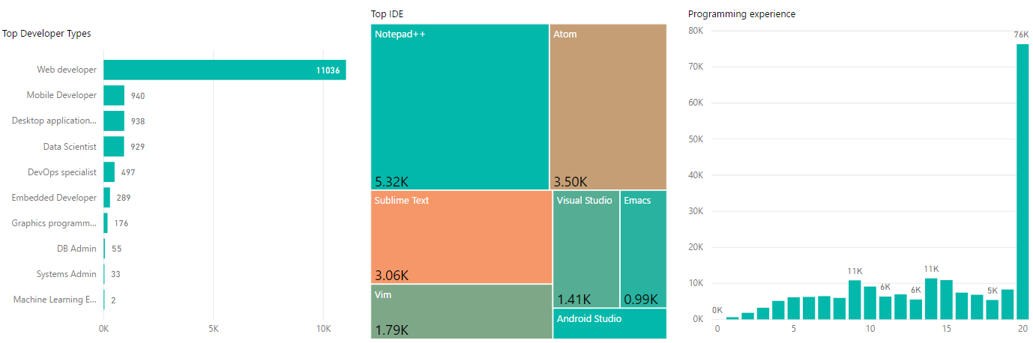
Around 11,000 developers are web developers . That might be the reason that AngularJS tops the bucket list of most of the developers
Interestingly Notepad++, Atom and Sublime Text are the most popular IDEs among stack overflow developers
76,000 developers have programming experience close to 20 years. This may be one of the reasons why stackoverflow solutions are optimal and works most of the time

Slide 10
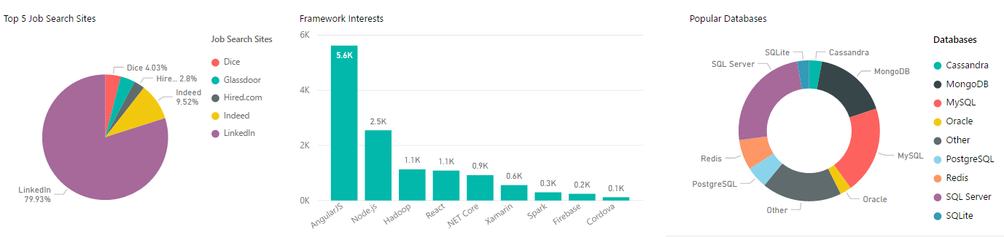
LinkedIn is the preferred job search portal for 80% of the stack overflow developers
Close to 5600 developers have AngularJS as their next learning framework. Most of the framework interests for the developers are related to web and data technologies
SQL Server and MySQL are the most popular databases

Slide 11
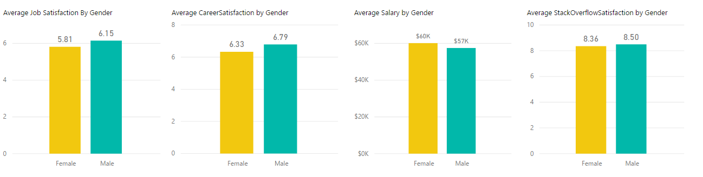
The job satisfaction score is almost the same for both Female and Male developers
The career satisfaction score is almost the same for both Female and Male developers
Female developers earns a slightly higher salary when compared to Male developers
The stack overflow website satisfaction score is almost the same for both Female and Male developers. Average is 8 out of 10 which is very good

Slide 12
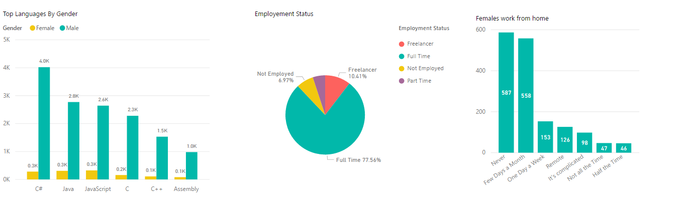
While Male developers prefer to code in C#. Female developers prefer C#, Java and Javascript
Close to 78% of stackoverflow developers are employed while a few are freelancers
A high number of Female developers don’t prefer to work from home or work from home a few days a month

Slide 13

Conclusion
With the amount of data available from the survey results the analysis can go to any length and depth
The intention of this analysis was to get a high level overview of the survey results
The data is openly available on the kaggle website [https://www.kaggle.com/stackoverflow/so-survey-2017/data]
This survey holds the key to future community contributors to analyze what the current developers interests are

Slide 14

Thank You

